Slide 1
Viterbi Decoder Architecture
How to Build It

Slide 2
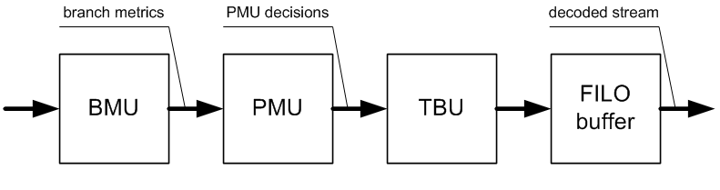
Top Level Block Diagram
BMU = Branch Metric
PMU = Path Metric
ACS = Add, Compare, Select -- component withing PMU
TBU = Traceback Unit
FILO = RAM used as push/pop stack

Slide 3
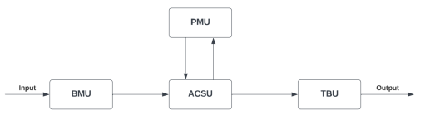
Viterbi Decoder Architecture
Branch Metric Unit
Path Metric Unit, aka ACSU
Add-Compare-Select Unit
TraceBack Unit

Slide 4
Branch Metric Unit
Computes Hamming distance between received signal and outputs of candidate internal encoders
This calculation assesses the similarity between the received and possible transmitted signals. The BMU processes these metrics for each received symbol or bit and forwards the results to the Path Metric Unit.

Slide 5
Path Metric Unit / Add-Compare-Select
Summarizes competing path metrics for 2^{K-1} paths.
Updates path metrics by adding branch metrics from the BMU.
Tracks the better path's cumulative metric for each trellis state
Compares all paths leading to each state and selects the one with the lowest metric = most probable path.
Repeats at each stage, providing a set of most likely (survivor) paths for each state.
This facilitates pruning of the "loser paths."

Slide 6
TraceBack Unit (TBU)
Restores most likely path from PMU decisions.
Uses FILO (first in/last out) memory
Memory depth typically 5*(K-1)
Works best if we know the starting and ending states -- facilitate this by using a 0, 0, 0 preamble and 0, 0, 0 postamble with the message body.

Slide 7
Traceback Unit (TBU)
Identifies the most probable sequence of states, following the processing of received symbols by the PMU.
Retraces the trellis from the final state with the lowest path metric.
Starts at the end of the trellis structure, and traces back through the survivor paths using pointers or references, to determine the most probable transmitted sequence.
The length of the traceback is determined by the constraint length of the convolutional code, impacting both the decoding latency and complexity.
Upon completing the traceback process, the decoded data is output, with appended tail bits removed.

Slide 8
Hard vs. Soft Decoding
Hard decoding is easy; soft decoding is hard.
We are doing hard decoding in this class.
In a noisy channel, in which data points are not crisp 1 and 0 (or 1 and -1) values, soft decoding will provide more reliable error correction.
As with any error correction algorithm, if errors come too frequently or in bursts, our system will not be able to perform properly. It may introduce new errors while failing to correct some of the existing errors.

